Slide 1
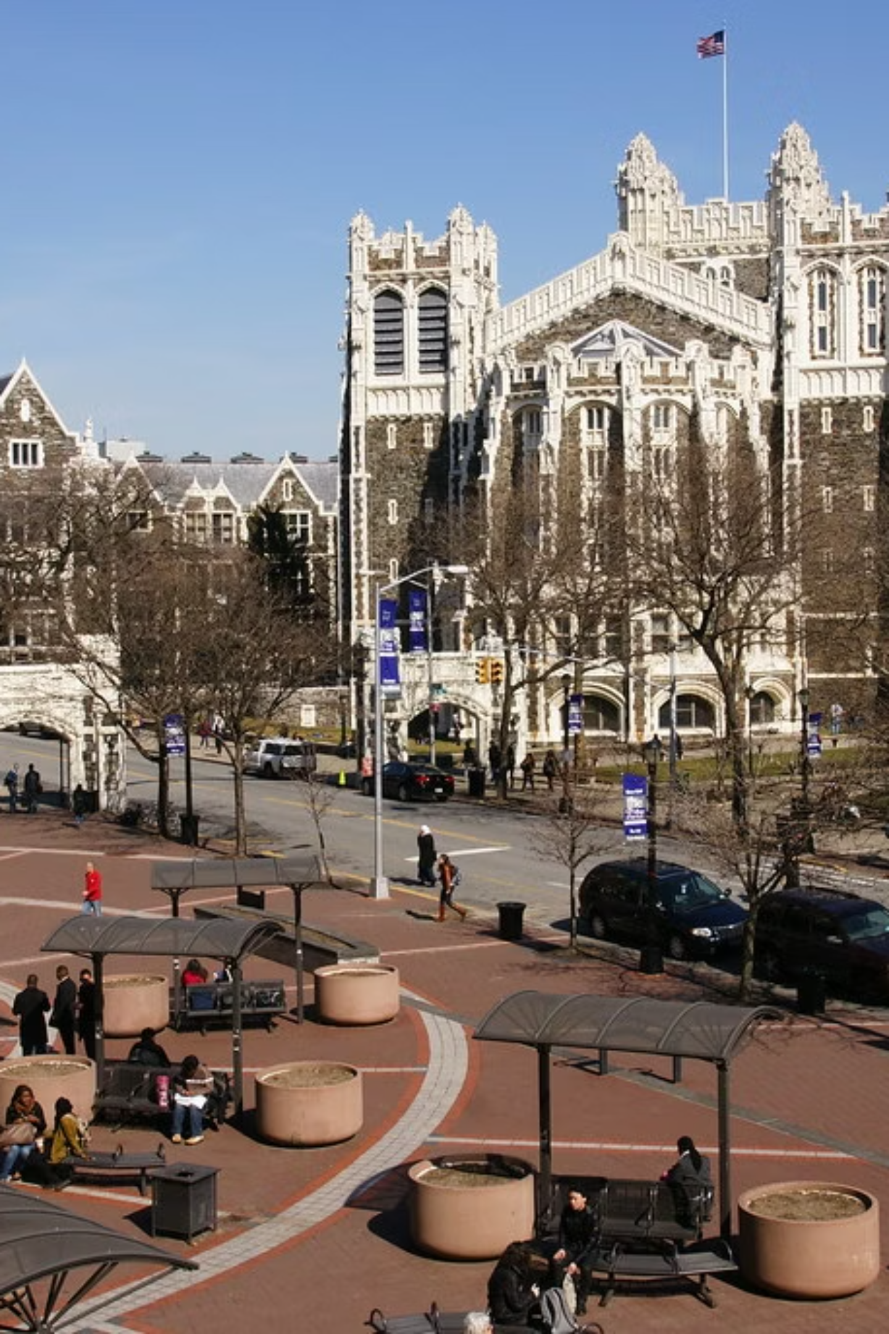
Beavers Campus Event Ticketing & Revenue System
Final Team Project Demonstration (CSC 336)
Team: Sri Subramanian, Sanskriti Khadka, Maaz Qasim, Mahir Shahriar, Avirup Ray, Ibsan Hossain

Slide 2
Presentation Roadmap
01
02
03
Team Introduction
Core Use Cases
Live Demonstrations
Meet the developers behind the Beavers Ticketing System.
Understanding the key user journeys through our platform.
See the system in action with real-time scenarios.
04
05
06
Stored Procedures
Relational Model
Key Takeaways
Dive into the database logic powering our efficiency.
An overview of our robust database architecture.
Lessons learned and project highlights.
07
Q&A Session
Your chance to ask us anything about the project.

Slide 3
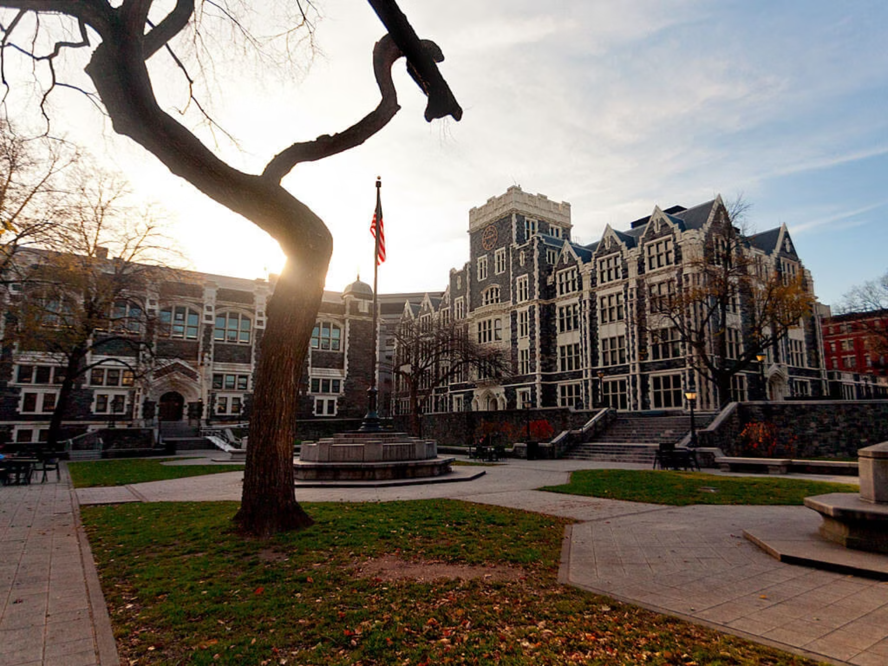
Vision
Business Innovation
Our platform provides a centralized hub for campus organizations to effortlessly publish events and sell tickets. It offers real-time revenue tracking, empowering organizations with immediate financial insights and robust event management tools.
The system ensures financial sustainability by automatically applying a 7% platform fee to every ticket sale.

Slide 4

Architecture
Technical Foundation
Built on a modern and scalable tech stack, our system combines robust performance with development agility:
Backend: Python (Flask) for powerful API and business logic. (Maaz Qasim, Mahir Shahriar)
Database: MySQL for reliable and structured data storage. (Sanskriti Khadka, Sri Subramanian)
Frontend: Jinja2/HTML for dynamic, server-side rendered user interfaces. (Avirup Ray, Ibsan Hossain)
Deployment: Docker containerization for seamless development and deployment environments.

Slide 5



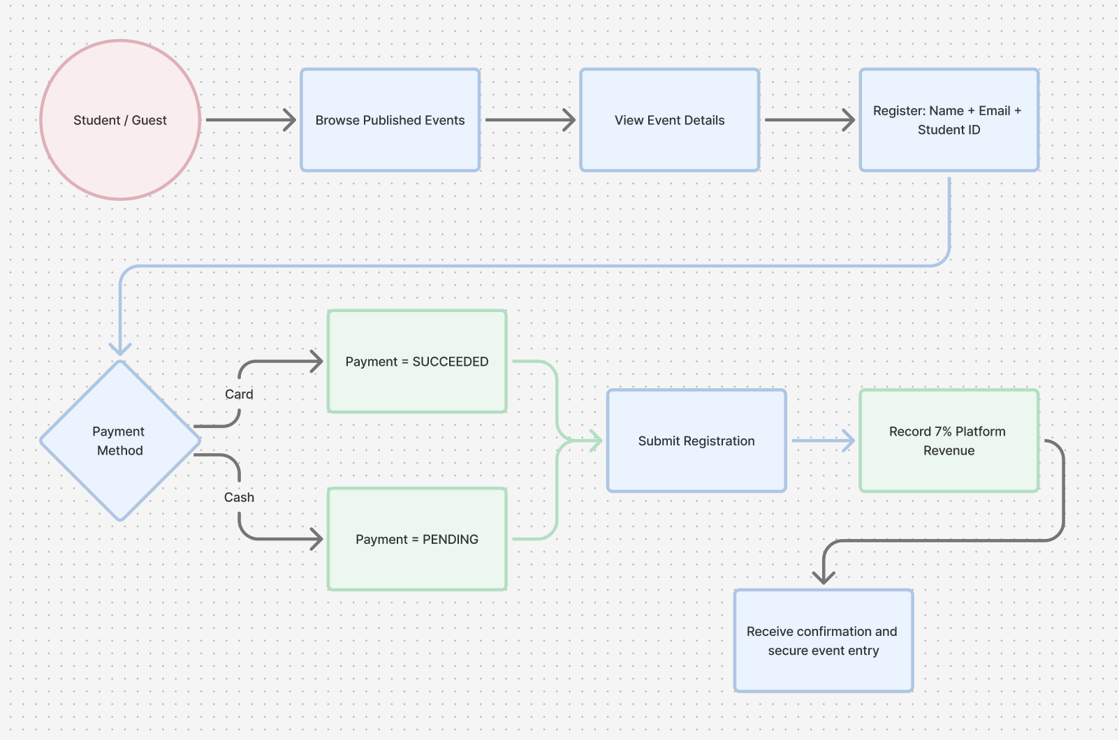
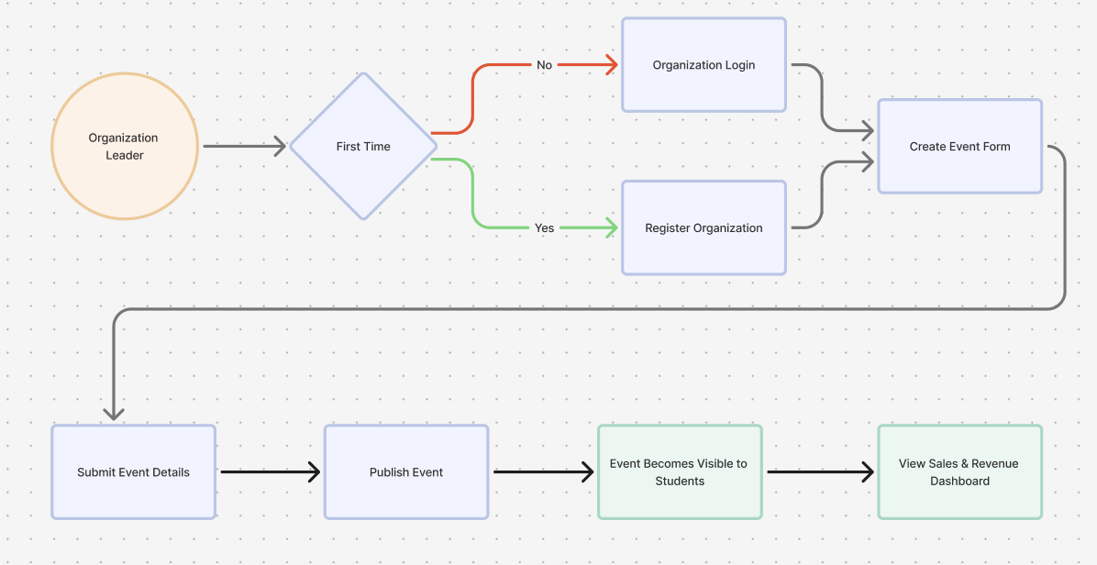
Streamlined User Journeys

Slide 6
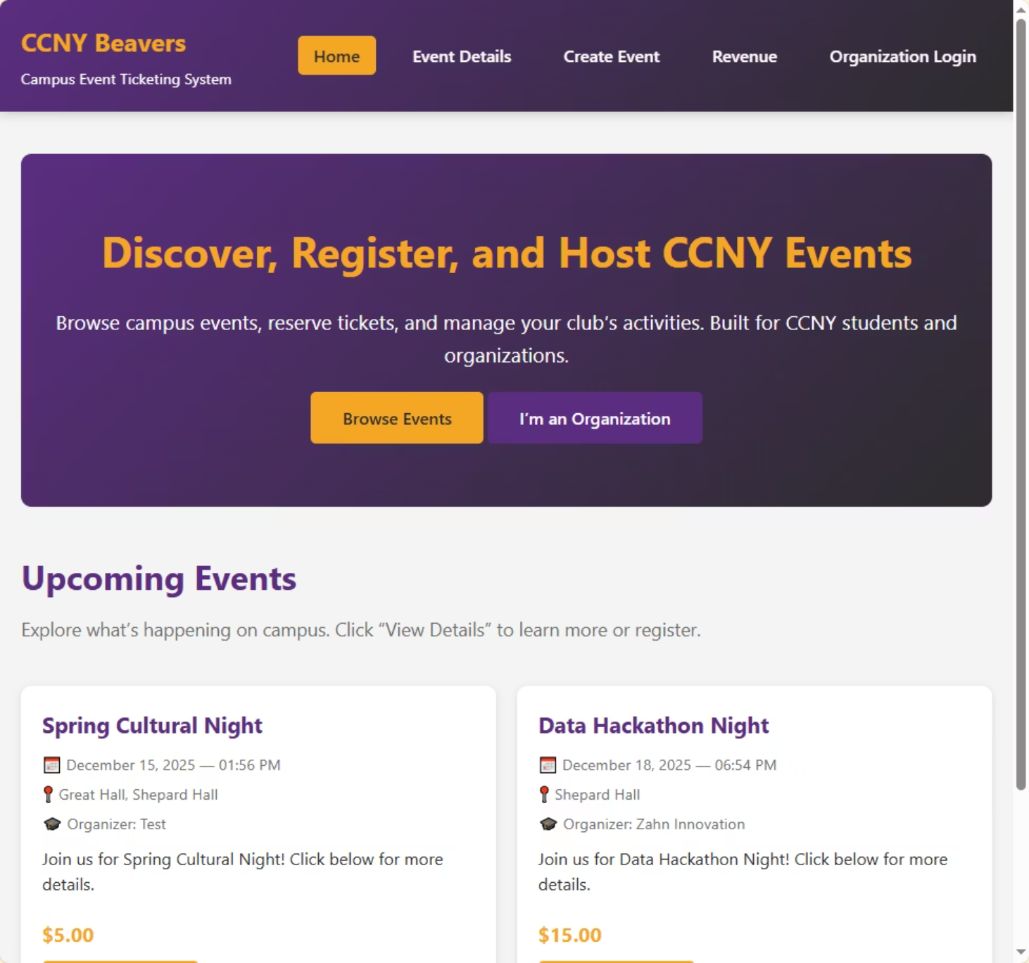
Intuitive Interface & Navigation Demo
Responsive Web Dashboard
A clean, responsive web dashboard built with server-side rendered templates ensures fast loading times and a seamless experience across all devices. We prioritized a user-friendly design to maximize engagement.
Public & Admin Views
Public users are greeted with an engaging event gallery, while administrators access a secure, feature-rich management panel tailored for their needs.

Slide 7
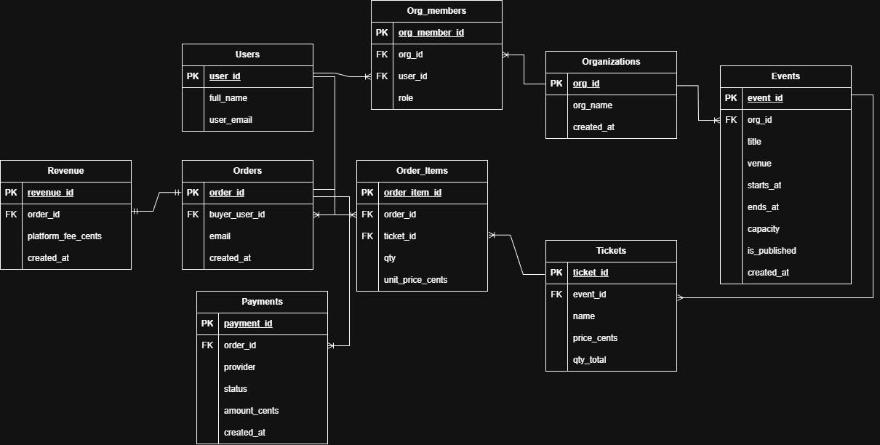
Robust 2NF Relational Model

Slide 8


Optimized Operations with Stored Procedures
Stored procedures are crucial for enhancing performance and maintaining data consistency directly within the database layer.
Procedure 1: CreateEventWithTicket
Procedure 2: GetOrgRevenueReport
Function: Atomically inserts a new event and its default "General Admission" ticket type in a single, efficient execution.
Function: Aggregates sales data from five joined tables (Events, Tickets, Orders, Order_items, Payments) to calculate total revenue per event.
Efficiency: Prevents "orphan" events that lack tickets, guaranteeing every event created is ready for sales, improving data integrity.
Efficiency: Significantly reduces network traffic and application load by performing complex summations and groupings directly on the database server.

Slide 9



Key Learning & Project Takeaways
ACID Transactions
Mastering ACID transactions was critical, especially when updating multiple interdependent tables like Orders, Payments, and Revenue simultaneously.
Effective Use of JOIN
Implemented LEFT JOIN to ensure all events, even those with zero sales, are accurately represented in dashboard reports, providing comprehensive insights.

Slide 10



Extra Credit & Advanced Features
Robust Containerization
Database Optimization
UX-Focused Web UI
Deployed the entire application (Flask backend + MySQL database) using Docker Compose running on DigitalOcean, creating a professional microservices environment.
Implemented CREATE INDEX on foreign keys (org_id, event_id, order_id) to drastically improve JOIN operation performance.
Designed a responsive, semantic HTML5 interface with custom CSS for an aesthetically pleasing and user-friendly event browsing experience.

Slide 11

Thank you for listening! Any Questions?

